Slide 1

Multimedia Systems Project
Media Player

Slide 2
Media Player
Prepared By :-
1- Mohamed Naggar Mohamed.
2- Mohsen Saadan Mohamed.
Supervised by
Dr. Khaled Fathy.

Slide 3
Project Functionality
Play audio files.
Play video files.
Play audio cds.

Slide 4
Media Player GUI -1
GUI divided to 4 forms.
1- Now Playing tab for show video .
2-Play list tab to view the list of media files which will play.
3-Setting tab to put the setting the media player.
4-Help Tab which view the help of media player.

Slide 5
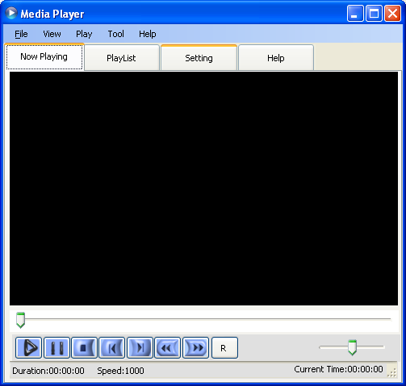
Media Player GUI -1

Slide 6
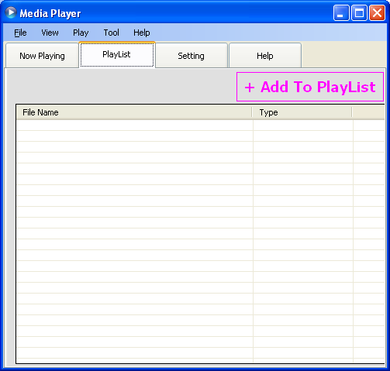
Media Player GUI -2

Slide 7
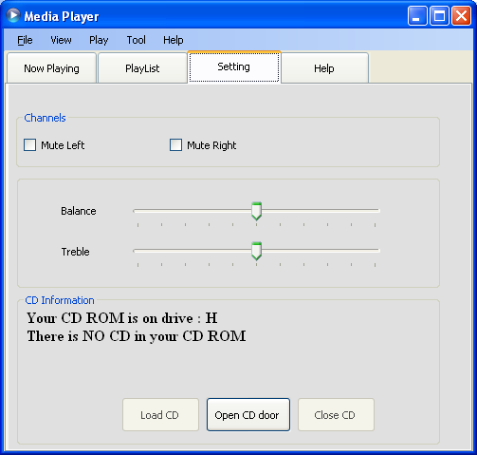
Media Player GUI -3

Slide 8
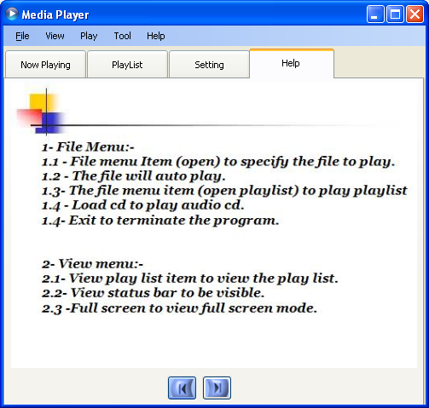
Media Player GUI -4

Slide 9
Media Player Classes
Media File class.
Sound File class.
Video File class.
Play list class.
MediaException class.
End

Slide 10
Media File class
protected void Open(string file) .
public void Play(int from, int length).
public void Stop().
private void DoMute().
private void DoBalance().
private void DoSpeed().
protected string TimeFormat .
public int Length .
public int Position .
public int Volume .
CD functions.

Slide 11
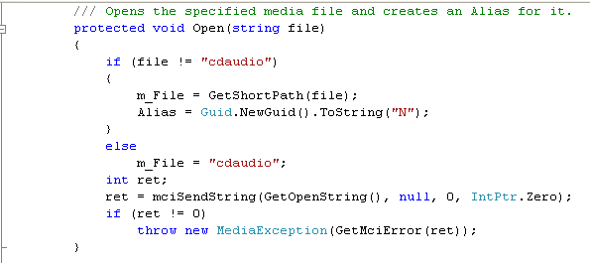
protected void Open(string file) .

Slide 12
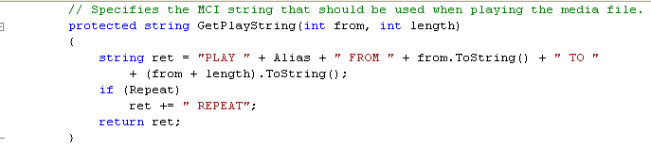
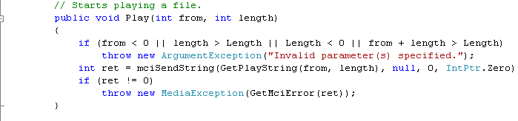
public void Play(int from, int length).

Slide 13
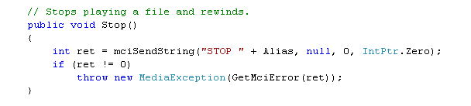
public void Stop().

Slide 14
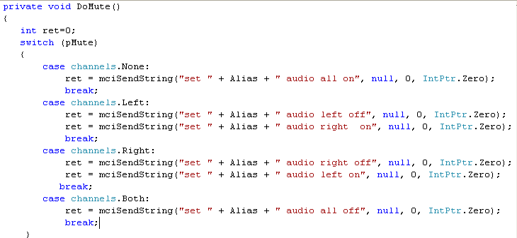
private void DoMute().

Slide 15
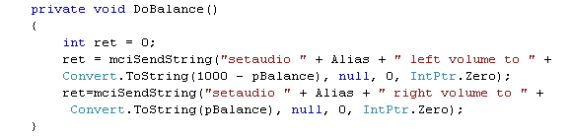
private void DoBalance().

Slide 16
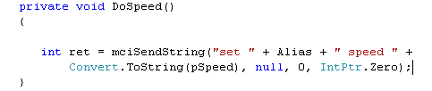
private void DoSpeed().

Slide 17
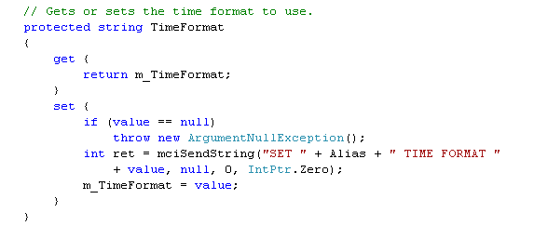
protected string TimeFormat .

Slide 18
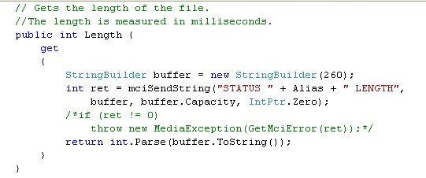
public int Length .

Slide 19
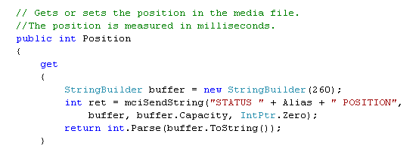
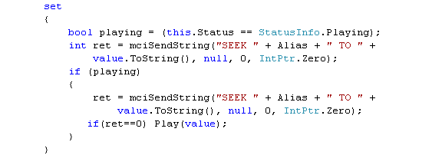
public int Position .

Slide 20
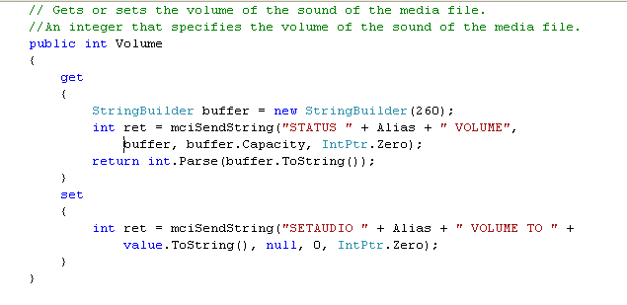
public int Volume .

Slide 21
CD functions.
public void playFromTrackCD(int TrackN)
public void playFromT_M_SCD(int T, int M, int S)
public String pauseCD()
public string lengthCD()
public void stopCD()
public void openCDdoor()
public void closeCDdoor()

Slide 22
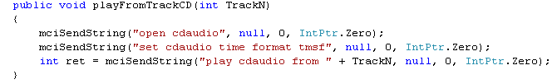
public void playFromTrackCD(int TrackN)

Slide 23
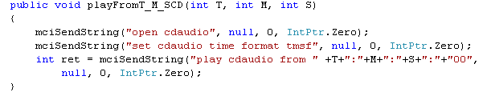
public void playFromT_M_SCD(int T, int M, int S)

Slide 24
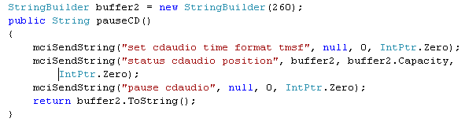
public String pauseCD()

Slide 25
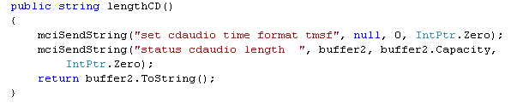
public string lengthCD()

Slide 26

public void stopCD()

Slide 27

public void openCDdoor()

Slide 28

public void closeCDdoor()

Slide 29
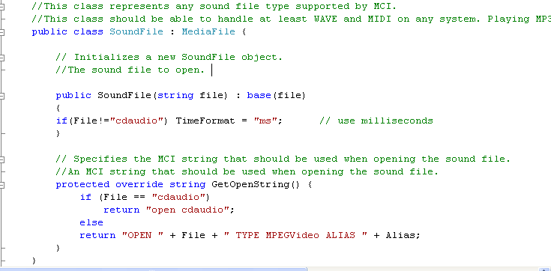
Sound File class.

Slide 30
Video File class.
protected override string GetOpenString()
public void FullScreen()
public Rectangle OutputRect

Slide 31
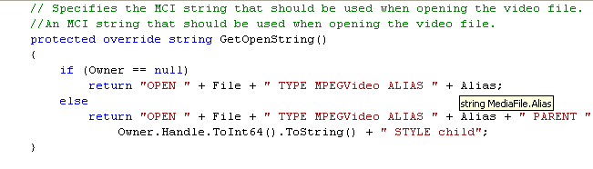
protected override string GetOpenString()

Slide 32
public void FullScreen()

Slide 33
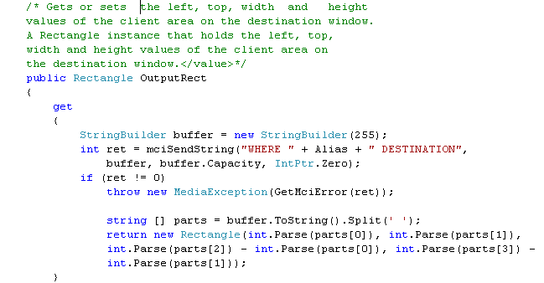
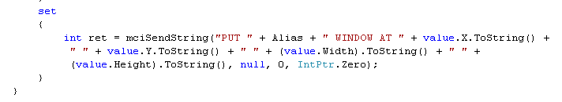
public Rectangle OutputRect

Slide 34
Play list class.
private void Readplaylist ()
public void CreatePlayList(string sFileName,string[]files

Slide 35
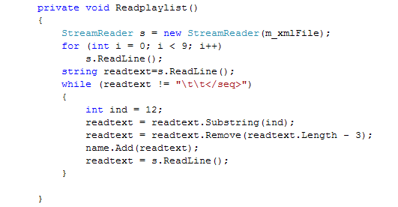
private void Readplaylist ()

Slide 36
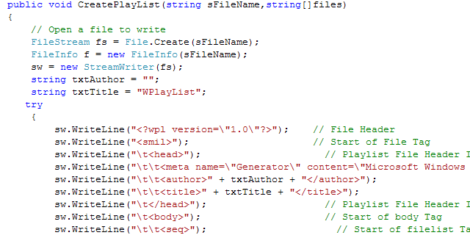
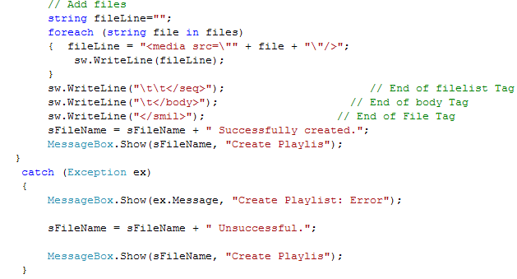
public void CreatePlayList(string sFileName,string[]files

Slide 37
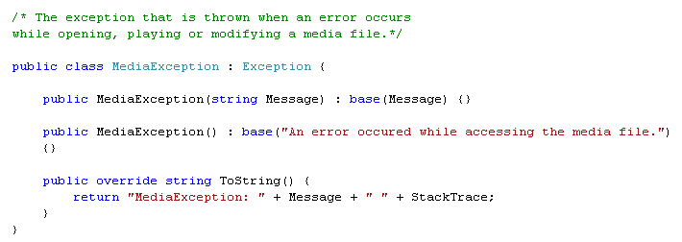
MediaException class

Slide 38
THE END

